Slide 1


How to Talk so Engineers will Listen:
R in Production at T-Mobile
Cascadia R Conf
June 8th, 2019
Heather Nolis, Machine Learning Engineer, T-Mobile – @heatherklus
Sai Jyotsna, Senior Software Engineer, Logic 2020

Slide 2
Who We Are

Slide 3




The project:
Goal Use machine learning to improve the customer experience
Scope customer care messaging

Slide 4

Scenario Customer sends message:
“This high bill shall not pass!”
Goal Prep customer care agent before first response: Current bill status
Method
Classify the message with machine learning: [bill breakdown]
Improve the prediction with customer data:
Recent account activity
Signal strength
Bill status [overdue]

Slide 5
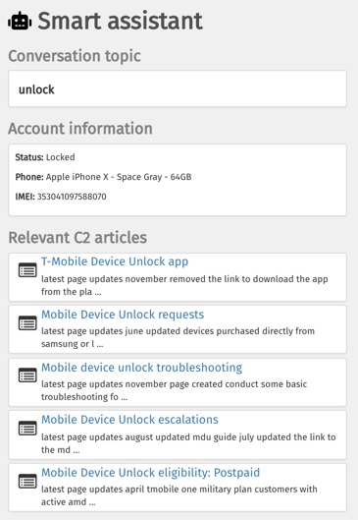


Product: Expert Assistant
Hey! I’m travelling to Europe and need my phone to work.
I see your phone is locked. I’ll submit an unlock request now.

Slide 6






Team Snapshot, January 2018
DREAM

Slide 7

Team Snapshot, May 2019
We are:
2 product development teams
20 total people
with services in 5 languages
using 7 different data stores and 9 backend systems
Our products are
Used by all 600 T-Mobile messaging agents
Triggered over 5 million times a week
“This really helps our agents become more efficient in resolving our customers’ needs.” – Care Center Supervisor

Slide 8
Inspiration

Slide 9
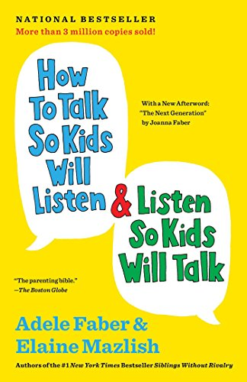
Communication across disciplines is hard
“the difference… between the words that make it impossible for a child to think or concentrate and the words that free the natural desire to learn”

Slide 10
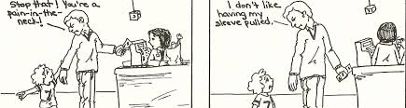
How To Talk So Kids Will Listen
Instead of reacting in anger, talk about your feelings.

Slide 11
Value Conflicts

Slide 12
Value Conflict: Accuracy vs Uptime
Data Scientist
Software Engineer
Feels good when
models, analyses, and insights are highly accurate
Can lead to
Holding onto work until it’s “fully complete”
Feels good when
systems are always on, performant, and scalable
Can lead to
Lack of interest in the unknown

Slide 13
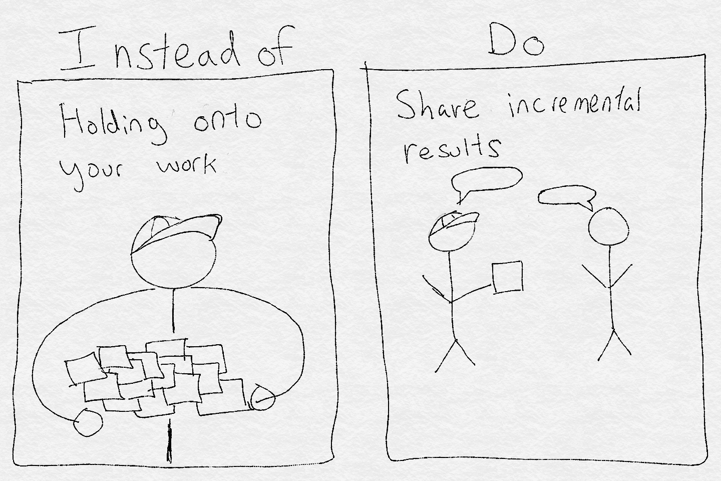
Communication cadence matters.
Team Tip: A definition of done for engineering and data science tasks provides clarity and reduces friction!

Slide 14
T-Mobile Example
“It works but I’m still tuning the hyperparameters”

Slide 15
Value Conflict: Insights vs Completed Code
Data Scientist
Software Engineer
Measure success by
understanding of patterns in data
Can lead to
discussions about the model that don’t address engineering worries
Measure success by
working code
Can lead to
extra work created by unforeseen troubles and dependencies

Slide 16
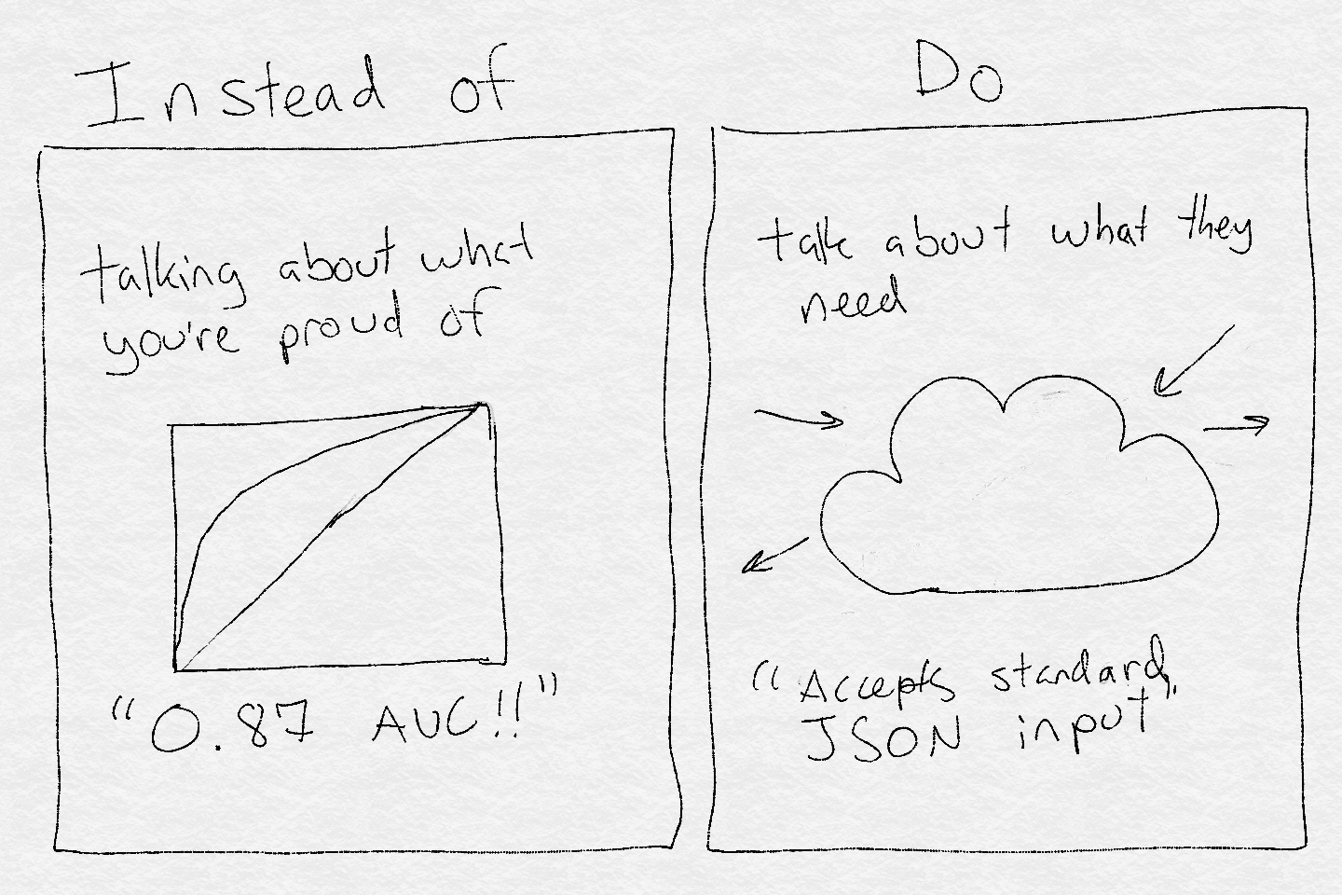
Engineers have different needs.
Team Tip: If dealing with an agile team, make sure to understand their sprints

Slide 17
T-Mobile Example
“API documentation will be done after the model is finished”

Slide 18
Value Conflict: Reproducible vs Explainable
Data Scientist
Software Engineer
Needs to understand
experiments done to reach the conclusion
Can lead to
communicating for scientific clarity and reproducibility
Needs to understand
what things do
Can lead to
assuming concepts are over their head

Slide 19
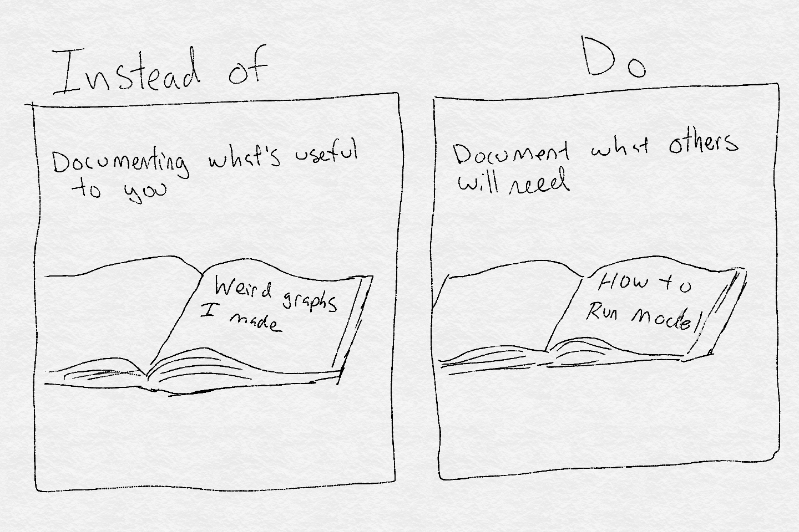
Different roles need different documentation.
Team Tip: Documentation for engineers is easily stored in git repositories

Slide 20
T-Mobile Example
“Documentation? It sits across several Rmarkdown files on my computer”

Slide 21
Shortcut

Slide 22


How many engineers does it take to convince other engineers a data scientist’s idea is a good idea?
1
Goal: gain the technical trust of one engineer.

Slide 23
What We’ve Learned

Slide 24

Establish Communication Rituals
Disciplines
“Think of this as a union.”
Goal: Smooth processes internal to and between disciplines.
Examples: product, engineering, data science, architecture
Knowledge Transfer Sessions
1 hour/week
Internal and external speakers
Relevant to both teams

Slide 25
Collaboration starts with the environment.
Sit next to each other.
Create separate definitions of done.
Establish communication rituals.
Get (at least) one engineer friend.
During conflict, always
look for what the other discipline values.
treat that value with respect
remember that you’re each other’s customer

Slide 26
Wrapping it up
Collaboration requires work
Data scientists have to be ready for rules
Software engineering has been around a lot longer
Software engineers have to be ready for ambiguity
The point of data science is to learn new things
Data scientists are just as technical as engineers—you can work together!

Slide 27



Materials: bit.ly/r-cascadia-tmo

